Slide 1

Lecture 6 Java Internationalization Part 1
Reference:
Java-Tutorials/tutorial-2015/index.html

Slide 2
Objectives
How to create a Java program which can be easily customized to run it all over the world?

Slide 3
Contents
1- Internationalization
2- Localization
3- Which contents of a program can be internationalized?
4- A way to Internationalize a Program
5- Basic Java APIs for Internationalization
6- Steps for Internationalizing a Program
7- A Demonstration

Slide 4
1- Internationalization?
Internationalization is the process of designing an application so that it can be adapted to various languages and regions without engineering changes. Sometimes the term internationalization is abbreviated as i18n, because there are 18 letters between the first "i" and the last "n.“
An internationalized program has the following characteristics:
With the addition of localized data, the same executable can run worldwide.
Textual elements, such as status messages and the GUI component labels, are not hardcoded in the program. Instead they are stored outside the source code and retrieved dynamically.
Support for new languages does not require recompilation.
Culturally-dependent data, such as dates and currencies, appear in formats that conform to the end user's region and language.
It can be localized quickly.
Notes:
Internationalization (i18n): the process of changing the software so that it isn't hardwired to one language/locale/culture.
Localization (l10n): the process of adding the appropriate resources to the software so that a particular language/locale is supported.

Slide 5
2- Localization?
Localization is the process of adapting software for a specific region or language by adding locale-specific components and translating text. The term localization is often abbreviated as l10n, because there are 10 letters between the "l" and the "n."
The primary task of localization is translating the user interface elements and documentation. Localization involves not only changing the language interaction, but also other relevant changes such as display of numbers, dates, currency, and so on. Other types of data, such as sounds and images, may require localization if they are culturally sensitive. The better internationalized an application is, the easier it is to localize it for a particular language and character encoding scheme.

Slide 6
3- Which contents of a program can be internationlized?
GUI Program
Console Program
Guidelines for user
Input
Output
GUI
Labels
Inputs from user
Output
Messages in dialogs
Contents | Objectives | Characteristic
Labels, guideline | Helping user easily using the program | It can be modified to make conformity with user
Inputs | Getting data | Language keyboard language is used by users
Messages | Communication between the program and users | It can be modified to make conformity with user
Unicode makes your wish come true

Slide 7
4- A way to Internationalize a Program
File 1 for US
Key1 = US-Val1
Key2 = US-Val2
Key3 = US-Val3
Program
ResourceBundle message;
String s= getString(KeyX);
File 1 for VN
Key1 = VN-Val1
Key 2= VN-Val2
Key3 = VN-Val3
Bundles
File 1 for Japan
Key1 = JP-Val1
Key2 = JP-Val2
Key3 = JP-Val3
An object (resourceBundle) bundles (associates) with a specific file in which contents are prepared as pairs <K,V>
File 1 for …
Key1 = …
Key3 = …
Key4 = J…

Slide 8
5- Basic Java APIs for Internationalization
Class | Description
java.util.Locale | A Locale object represents a specific geographical, political, or cultural region. Data: language, country Some constants are defined for some locales
java.util.ResourceBundle | Resource bundles contain locale-specific objects. When your program needs a locale-specific resource, a String for example, your program can load it from the resource bundle that is appropriate for the current user's locale. A template file for this goal was defined including pairs <key, value> Filename of a resource bundle must be: prefix_language_NATION.properties (prefix: user-defined string) Examples: MessagesBundle_de_DE.properties MessagesBundle_en_US.properties MessagesBundle_vi_VN.properties (prefix = MessagesBundle)

Slide 9
6- Steps for Internationalizing a Program
Step | Description
1 | Determining means data will be presented to user
2 | Creating resource file using the format: Key1 = Value1 Key2 = Value2 …
3 | Develop the program. All data presented to users must be gotten from the appropriate resource file using classes Locale, ResourceBundle
4 | Making program configuration using the syntax: java package. class language nation Example java package.class vi VN

Slide 10
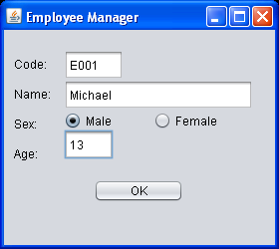
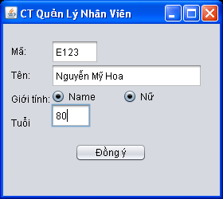
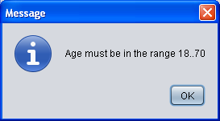
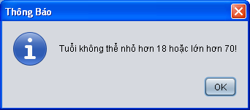
Demo 1
This demonstration depicts steps to develop an international program.
The program is used in US
The program is used in VN

Slide 11
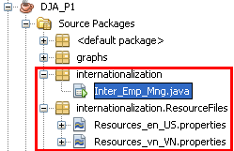
Demo 1…
Create New Folder
New Properties File

Slide 12

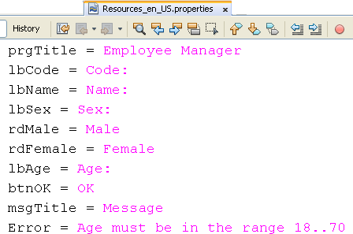
Demo 1…
Step 1: Determining means data will be presented to user
Step 2: Create resource files

Slide 13
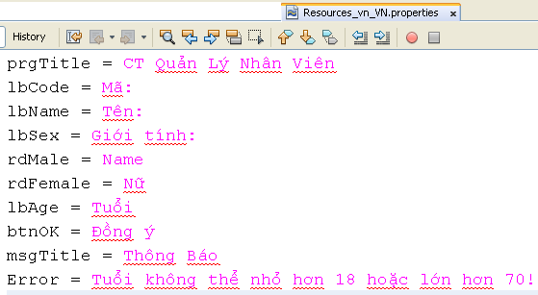
Demo 1…

Slide 14
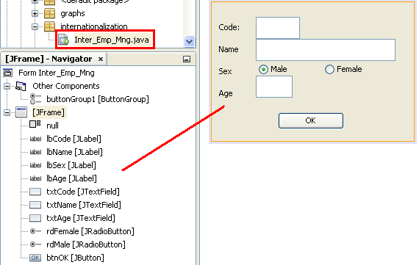
Demo 1…

Slide 15
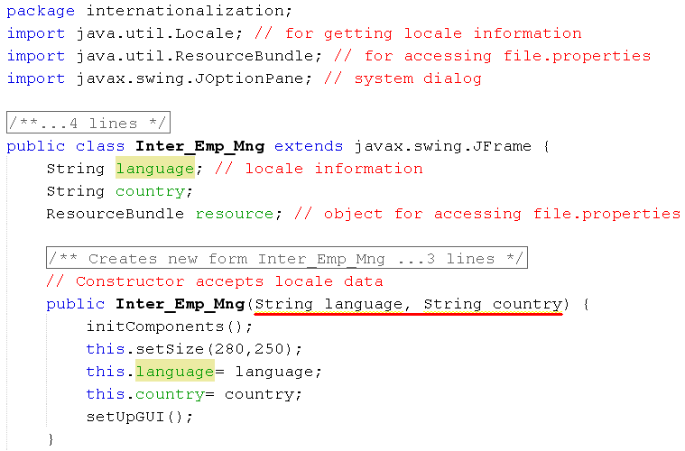
Demo 1…

Slide 16

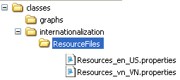
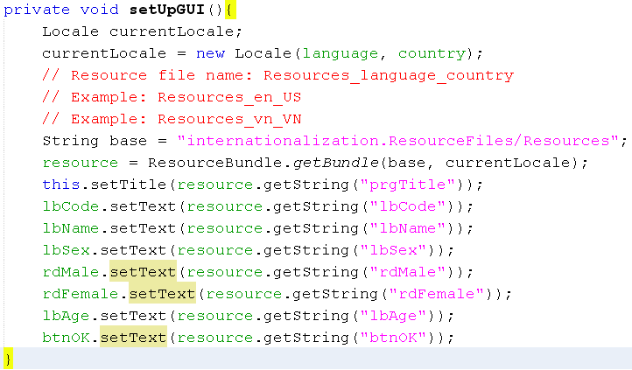
Demo 1…

Slide 17

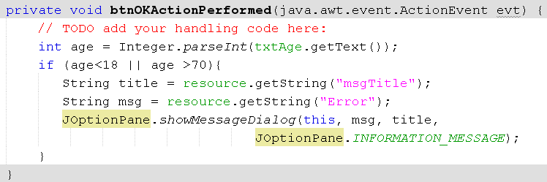
Demo 1…

Slide 18
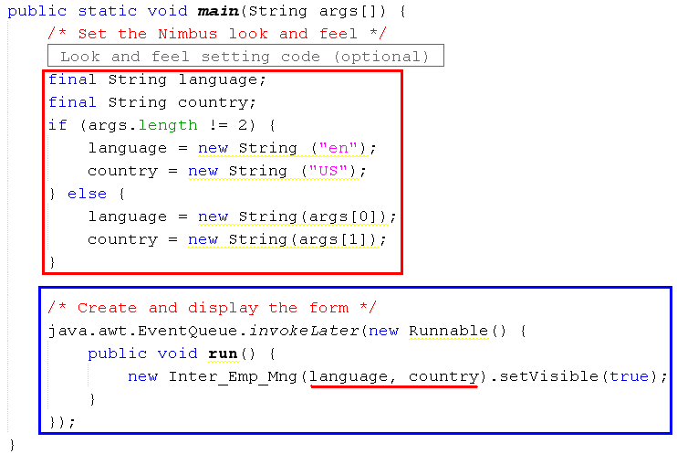
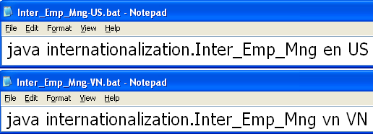
Demo 1…
Modify the entry point of the program. This makes a way to localization in the BAT file
This a an anonymous class declared in a method. So, it accesses constants only
A constant will be effect after it is assigned a value

Slide 19
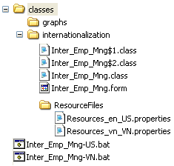
Demo 1…
Program Structure
You can create more locale resource files

Slide 20
Summary
1- Internationalization
2- Localization
3- Which contents of a program can be internationalized?
4- A way to Internationalize a Program
5- Basic Java APIs for Internationalization
6- Steps for Internationalizing a Program
7- A Demonstration

Slide 21
Thank You

